Slide 1

Space Invasion
By:
Sudyotman Sudershan,
Neelesh Mishra,
Nivranshu Singh Talwar
Kushanka Mitra

Slide 2
What is this game about?
Space Invasion is an offline game in which a player must counter hordes of incoming aliens. The objective of this game is to hold the aliens off as long as possible.
Once the enemy reach your platform, you are defeated and the enemy overruns you.
How long can you hold them off?

Slide 3
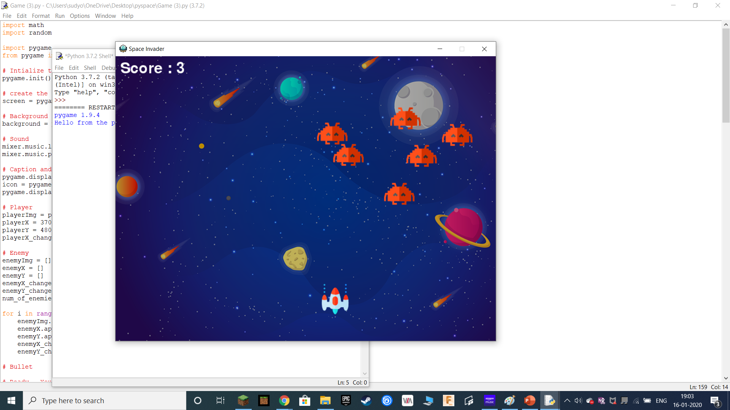
Game Screen
Score on the top left corner
Enemies on the right.
Player in Bottom layer

Slide 4
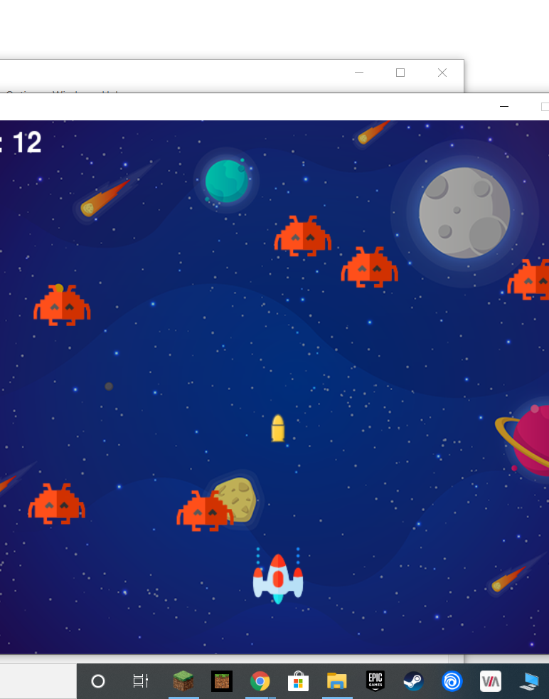
Shooting
As seen below, a player can only shoot a bullet once the bullet has crossed the screen

Slide 5
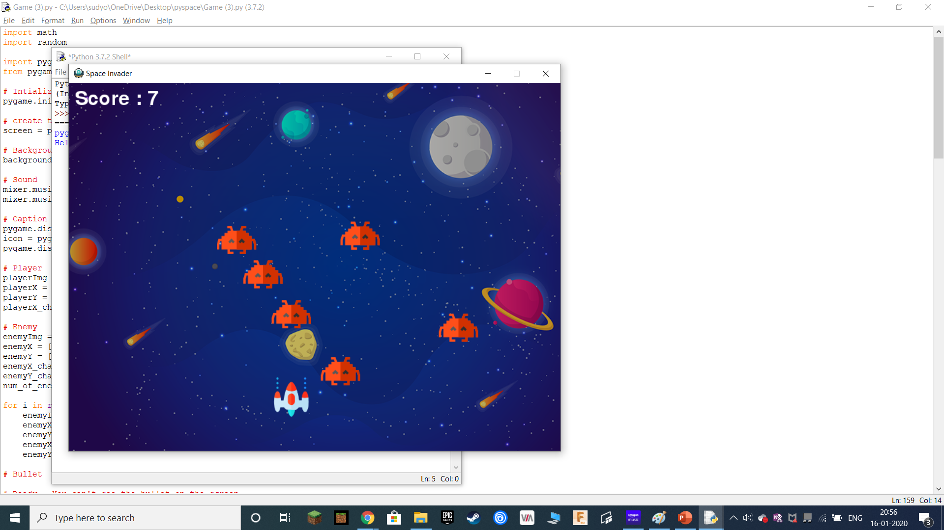
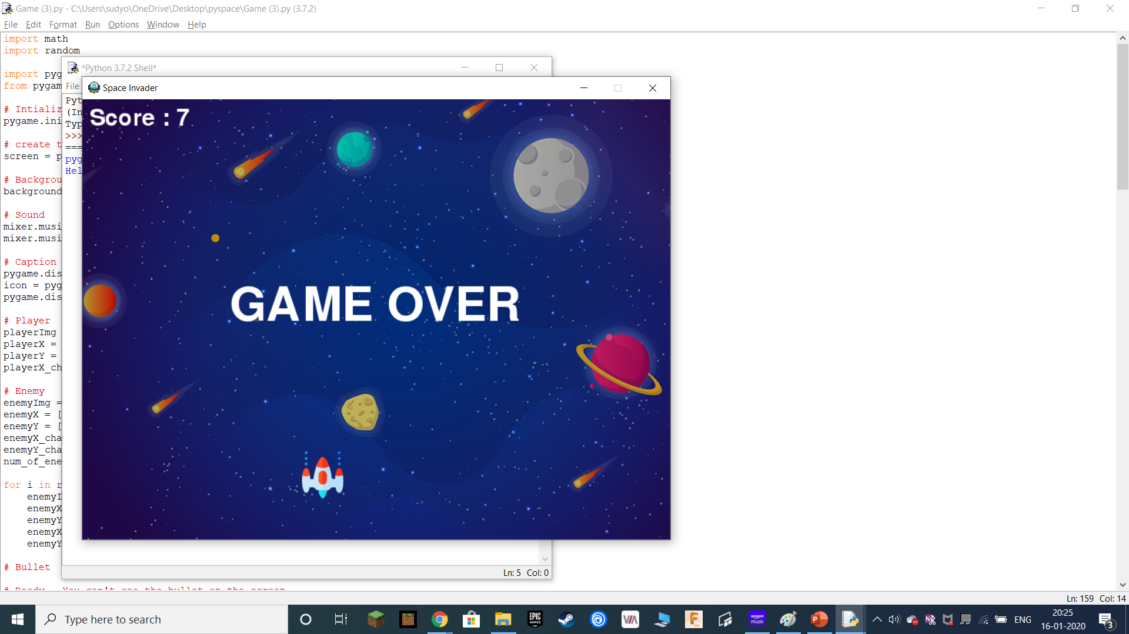
End of the game.
As much as a player might be a professional gamer, the aliens can overrun the player. In that case, the game ends.
Alien one layer away from defeating the player. The screen after the player is defeated.
The score remains on the screen.

